Slide 1

Explaining the output of machine learning systems
Scott Lundberg
Microsoft Research

Slide 2

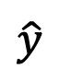
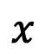
John
Customer data
Predicted risk
of default
$$x$$
DTI = 30
Delinquent = 10
model
$$\hat{y}$$
.
.
.
22%
Notes:
We'll start with a simple motivational example. This is John, a typical bank customer. Like many consumers today, when he applies for a loan, information about him is sent through a predictive model XX.
This model is designed to calculate the risk that John will have repayment problems, XX which, unfortunately for John, is 55%. And because his risk is high, the bank declines his loan application XX.
A natural first question John has XX is “Why?” The bank XX also want to know why, because these are key business decisions. But unfortunately for the data scientist that built this model XX, she used a complex model and so these questions are hard to answer XX …. XX

Slide 3

Jane
Customer data
Predicted risk
of default
$$x$$
DTI = 10
Delinquent = NA
model
$$\hat{y}$$
.
.
.
5%
Notes:
We'll start with a simple motivational example. This is John, a typical bank customer. Like many consumers today, when he applies for a loan, information about him is sent through a predictive model XX.
This model is designed to calculate the risk that John will have repayment problems, XX which, unfortunately for John, is 55%. And because his risk is high, the bank declines his loan application XX.
A natural first question John has XX is “Why?” The bank XX also want to know why, because these are key business decisions. But unfortunately for the data scientist that built this model XX, she used a complex model and so these questions are hard to answer XX …. XX

Slide 4
Customer data
Predicted risk
of default
$$x$$
DTI = 10
Delinquent = 10
model
$$\hat{y}$$
.
.
.
17%
Counterfactual explanation:
Example of how changing the input changes the output
Notes:
We'll start with a simple motivational example. This is John, a typical bank customer. Like many consumers today, when he applies for a loan, information about him is sent through a predictive model XX.
This model is designed to calculate the risk that John will have repayment problems, XX which, unfortunately for John, is 55%. And because his risk is high, the bank declines his loan application XX.
A natural first question John has XX is “Why?” The bank XX also want to know why, because these are key business decisions. But unfortunately for the data scientist that built this model XX, she used a complex model and so these questions are hard to answer XX …. XX

Slide 5
How-To: Counterfactual examples
Pick how you will modify the inputs
Pick what model output you will explain
Decide how you will rank the examples
Probability
High diversity
Local methods
Log-odds
High change / low distance
Loss
Dataset coverage
Global methods
etc.
etc.
Notes:
We'll start with a simple motivational example. This is John, a typical bank customer. Like many consumers today, when he applies for a loan, information about him is sent through a predictive model XX.
This model is designed to calculate the risk that John will have repayment problems, XX which, unfortunately for John, is 55%. And because his risk is high, the bank declines his loan application XX.
A natural first question John has XX is “Why?” The bank XX also want to know why, because these are key business decisions. But unfortunately for the data scientist that built this model XX, she used a complex model and so these questions are hard to answer XX …. XX

Slide 6
What can go wrong: Counterfactual examples
You are missing important model behavior because you don’t have examples that illustrate it.
You can’t discern meaningful patterns because there are too many examples to understand.
Few examples
Many examples
Notes:
We'll start with a simple motivational example. This is John, a typical bank customer. Like many consumers today, when he applies for a loan, information about him is sent through a predictive model XX.
This model is designed to calculate the risk that John will have repayment problems, XX which, unfortunately for John, is 55%. And because his risk is high, the bank declines his loan application XX.
A natural first question John has XX is “Why?” The bank XX also want to know why, because these are key business decisions. But unfortunately for the data scientist that built this model XX, she used a complex model and so these questions are hard to answer XX …. XX

Slide 7
Customer data
Predicted risk
of default
$$x$$
DTI = 10
Delinquent = 10
model
$$\hat{y}$$
.
.
.
model
model
16%
model
9%
model
10%
model
8%
10%
11%
Counterfactual explanation:
Example of how changing the input changes the output
Notes:
We'll start with a simple motivational example. This is John, a typical bank customer. Like many consumers today, when he applies for a loan, information about him is sent through a predictive model XX.
This model is designed to calculate the risk that John will have repayment problems, XX which, unfortunately for John, is 55%. And because his risk is high, the bank declines his loan application XX.
A natural first question John has XX is “Why?” The bank XX also want to know why, because these are key business decisions. But unfortunately for the data scientist that built this model XX, she used a complex model and so these questions are hard to answer XX …. XX

Slide 8
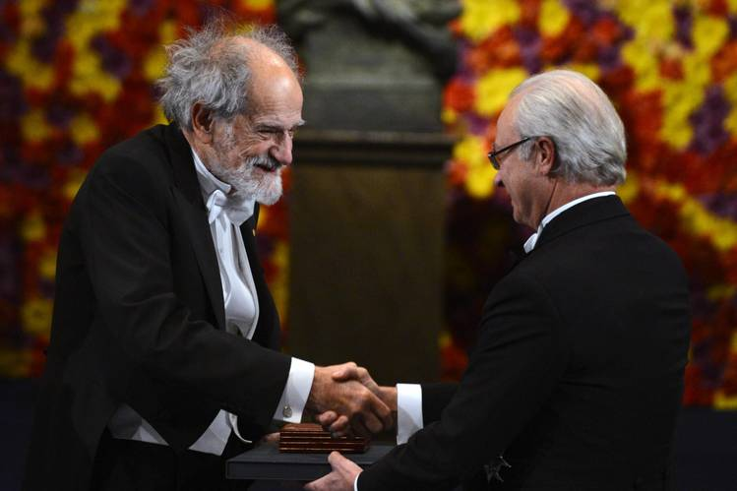
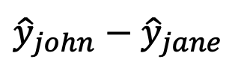
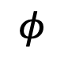
Lloyd Shapley
Attributions
$$φ$$
Change in prediction
+4
Nobel Prize in 2012
+7
∑
${\hat{y}}_{john}−{\hat{y}}_{jane}$
.
.
.
17%
Feature attribution explanation:
Summary of many counterfactuals.
Notes:
We'll start with a simple motivational example. This is John, a typical bank customer. Like many consumers today, when he applies for a loan, information about him is sent through a predictive model XX.
This model is designed to calculate the risk that John will have repayment problems, XX which, unfortunately for John, is 55%. And because his risk is high, the bank declines his loan application XX.
A natural first question John has XX is “Why?” The bank XX also want to know why, because these are key business decisions. But unfortunately for the data scientist that built this model XX, she used a complex model and so these questions are hard to answer XX …. XX

Slide 9

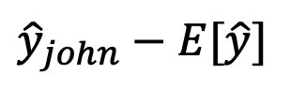
Attributions
$$φ$$
Change in prediction
-4
-6
∑
$${\hat{y}}_{john}−E[\hat{y}]$$
.
.
.
10%
Feature attribution explanation:
Summary of many counterfactuals.
Notes:
We'll start with a simple motivational example. This is John, a typical bank customer. Like many consumers today, when he applies for a loan, information about him is sent through a predictive model XX.
This model is designed to calculate the risk that John will have repayment problems, XX which, unfortunately for John, is 55%. And because his risk is high, the bank declines his loan application XX.
A natural first question John has XX is “Why?” The bank XX also want to know why, because these are key business decisions. But unfortunately for the data scientist that built this model XX, she used a complex model and so these questions are hard to answer XX …. XX

Slide 10
How-To: Feature attribution
Pick how you will modify the inputs
Pick what model output you will explain
Decide how you will summarize the examples
Probability
Shapley values
Local methods
Log-odds
Local kernel
Loss
Simple averaging
Global methods
etc.
etc.
Notes:
We'll start with a simple motivational example. This is John, a typical bank customer. Like many consumers today, when he applies for a loan, information about him is sent through a predictive model XX.
This model is designed to calculate the risk that John will have repayment problems, XX which, unfortunately for John, is 55%. And because his risk is high, the bank declines his loan application XX.
A natural first question John has XX is “Why?” The bank XX also want to know why, because these are key business decisions. But unfortunately for the data scientist that built this model XX, she used a complex model and so these questions are hard to answer XX …. XX

Slide 11
How-To: Feature attribution
Pick how you will modify the inputs
Pick what model output you will explain
Decide how you will summarize the examples
Probability
Shapley values
Local methods
Log-odds
Local kernel
Loss
Simple averaging
Loss
Global methods
etc.
etc.
Notes:
We'll start with a simple motivational example. This is John, a typical bank customer. Like many consumers today, when he applies for a loan, information about him is sent through a predictive model XX.
This model is designed to calculate the risk that John will have repayment problems, XX which, unfortunately for John, is 55%. And because his risk is high, the bank declines his loan application XX.
A natural first question John has XX is “Why?” The bank XX also want to know why, because these are key business decisions. But unfortunately for the data scientist that built this model XX, she used a complex model and so these questions are hard to answer XX …. XX

Slide 12
Model monitoring
Time
Training performance
Test performance
Can you find where we introduced the bug?
Notes:
Make title shorter

Slide 13
Model monitoring
False
True
Now can you find where we introduced the bug?
Notes:
Focus more on for each

Slide 14
Model monitoring
False
True
Time
Transient electronic medical record
Time
Notes:
What is an EMR?

Slide 15
Model monitoring
False
True
Time
Gradual change in atrial fibrillation
ablation procedure durations
Time
Notes:
Make title shorter

Slide 16
How-To: Feature attribution
Pick how you will modify the inputs
Pick what model output you will explain
Decide how you will summarize the examples
Probability
Shapley values
Local methods
Log-odds
Local kernel
Loss
Simple averaging
Global methods
Demographic parity fairness metric
etc.
etc.
Notes:
We'll start with a simple motivational example. This is John, a typical bank customer. Like many consumers today, when he applies for a loan, information about him is sent through a predictive model XX.
This model is designed to calculate the risk that John will have repayment problems, XX which, unfortunately for John, is 55%. And because his risk is high, the bank declines his loan application XX.
A natural first question John has XX is “Why?” The bank XX also want to know why, because these are key business decisions. But unfortunately for the data scientist that built this model XX, she used a complex model and so these questions are hard to answer XX …. XX

Slide 17
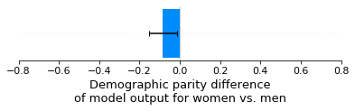
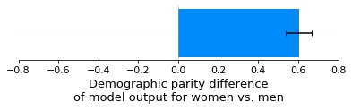
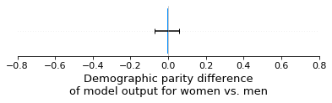
Scenario 1: No reporting errors
Scenario 2: An under-reporting bias for women’s income
Scenario 3: Under-reporting of women’s default rates, and an under-reporting of women’s job history.

Slide 18
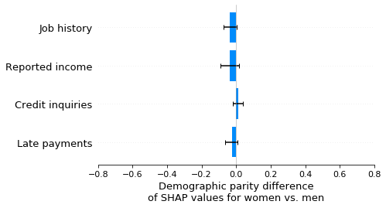
Scenario 1: No reporting errors

Slide 19
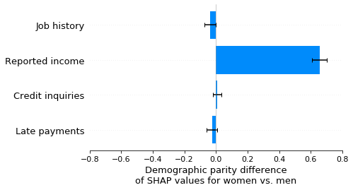
Scenario 2: An under-reporting bias for women’s income

Slide 20
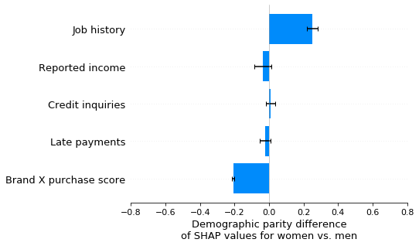
Scenario 3: Under-reporting of women’s default rates, and an under-reporting of women’s job history

Slide 21
How-To: Feature attribution
Pick how you will modify the inputs
Pick what model output you will explain
Decide how you will summarize the examples
Probability
Shapley values
Local methods
(gradient vs.
Log-odds
Local kernel
Loss
Simple averaging
Global methods
etc.
etc.
Notes:
We'll start with a simple motivational example. This is John, a typical bank customer. Like many consumers today, when he applies for a loan, information about him is sent through a predictive model XX.
This model is designed to calculate the risk that John will have repayment problems, XX which, unfortunately for John, is 55%. And because his risk is high, the bank declines his loan application XX.
A natural first question John has XX is “Why?” The bank XX also want to know why, because these are key business decisions. But unfortunately for the data scientist that built this model XX, she used a complex model and so these questions are hard to answer XX …. XX

Slide 22
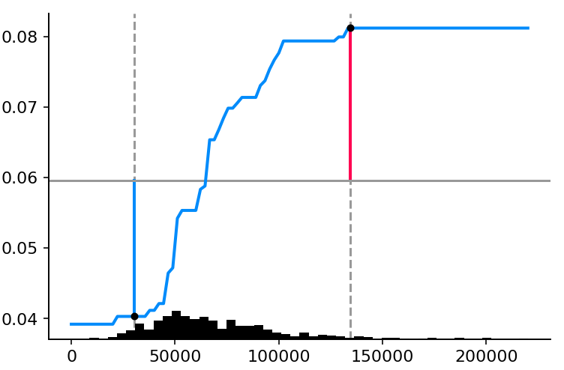
good “reason codes” ≠ good “action codes”
Because:
Some features are hard to change.
The math to identify the top reasons is different than the math to identify the best actions.
Low slope
High slope
High surprise
Low surprise
High information importance
(a good reason code, but poor action code)
High actionability importance
(a poor reason code, but good action code)

Slide 23
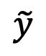
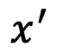
Attributions
Estimated prediction
$$x^{′}$$
∑ or tree or …
$$\tilde{y}$$
Mimic model explanations:
Generalization of feature attribution to any simple model type.
Notes:
We'll start with a simple motivational example. This is John, a typical bank customer. Like many consumers today, when he applies for a loan, information about him is sent through a predictive model XX.
This model is designed to calculate the risk that John will have repayment problems, XX which, unfortunately for John, is 55%. And because his risk is high, the bank declines his loan application XX.
A natural first question John has XX is “Why?” The bank XX also want to know why, because these are key business decisions. But unfortunately for the data scientist that built this model XX, she used a complex model and so these questions are hard to answer XX …. XX

Slide 24
How-To: Mimic models
Pick how you will modify the inputs
Pick what model output you will explain
Decide what model will mimic the original model
Probability
Linear model
Local methods
Log-odds
Rule list
Loss
GAM
Global methods
etc.
etc.
Notes:
We'll start with a simple motivational example. This is John, a typical bank customer. Like many consumers today, when he applies for a loan, information about him is sent through a predictive model XX.
This model is designed to calculate the risk that John will have repayment problems, XX which, unfortunately for John, is 55%. And because his risk is high, the bank declines his loan application XX.
A natural first question John has XX is “Why?” The bank XX also want to know why, because these are key business decisions. But unfortunately for the data scientist that built this model XX, she used a complex model and so these questions are hard to answer XX …. XX

Slide 25
What can go wrong: Feature attribution / mimic models
Your summarization of many counterfactuals hides too many details.
You don’t summarize a good set of counterfactuals.
Your summarization is itself too complex and difficult to understand.
Simple summary
Complex summary
Notes:
We'll start with a simple motivational example. This is John, a typical bank customer. Like many consumers today, when he applies for a loan, information about him is sent through a predictive model XX.
This model is designed to calculate the risk that John will have repayment problems, XX which, unfortunately for John, is 55%. And because his risk is high, the bank declines his loan application XX.
A natural first question John has XX is “Why?” The bank XX also want to know why, because these are key business decisions. But unfortunately for the data scientist that built this model XX, she used a complex model and so these questions are hard to answer XX …. XX

Slide 26
What can go wrong: Feature attribution / mimic models
Your summarization of many counterfactuals hides too many details.
You don’t summarize a good set of counterfactuals.
Your summarization is itself too complex and difficult to understand.
You don’t summarize a good set of counterfactuals.
Simple summary
Complex summary
Notes:
We'll start with a simple motivational example. This is John, a typical bank customer. Like many consumers today, when he applies for a loan, information about him is sent through a predictive model XX.
This model is designed to calculate the risk that John will have repayment problems, XX which, unfortunately for John, is 55%. And because his risk is high, the bank declines his loan application XX.
A natural first question John has XX is “Why?” The bank XX also want to know why, because these are key business decisions. But unfortunately for the data scientist that built this model XX, she used a complex model and so these questions are hard to answer XX …. XX

Slide 27
good “reason codes” ≠ good “action codes”
Because:
Some features are hard to change.
The math to identify the top reasons is different than the math to identify the best actions.
Low slope
High slope
High surprise
Low surprise
High information importance
(a good reason code, but poor action code)
High actionability importance
(a poor reason code, but good action code)

Slide 28
What can go wrong: Feature attribution / mimic models
Your summarization of many counterfactuals hides too many details.
Your summarization of many counterfactuals hides too many details.
You don’t summarize a good set of counterfactuals.
Your summarization is itself too complex and difficult to understand.
Simple summary
Complex summary
Notes:
We'll start with a simple motivational example. This is John, a typical bank customer. Like many consumers today, when he applies for a loan, information about him is sent through a predictive model XX.
This model is designed to calculate the risk that John will have repayment problems, XX which, unfortunately for John, is 55%. And because his risk is high, the bank declines his loan application XX.
A natural first question John has XX is “Why?” The bank XX also want to know why, because these are key business decisions. But unfortunately for the data scientist that built this model XX, she used a complex model and so these questions are hard to answer XX …. XX

Slide 29
Mortality risk model
Notes:
Make title shorter

Slide 30
Mortality risk model
Notes:
Make title shorter

Slide 31
Mortality risk model
Notes:
Make title shorter

Slide 32
Mortality risk model
Notes:
Make title shorter

Slide 33
Mortality risk model
Notes:
Make title shorter

Slide 34
Mortality risk model
Notes:
Make title shorter

Slide 35
Reveal rare high-magnitude mortality effects
Mortality risk model
Conflates the
prevalence of an effect
with the
magnitude of an effect
Notes:
Make title shorter

Slide 36
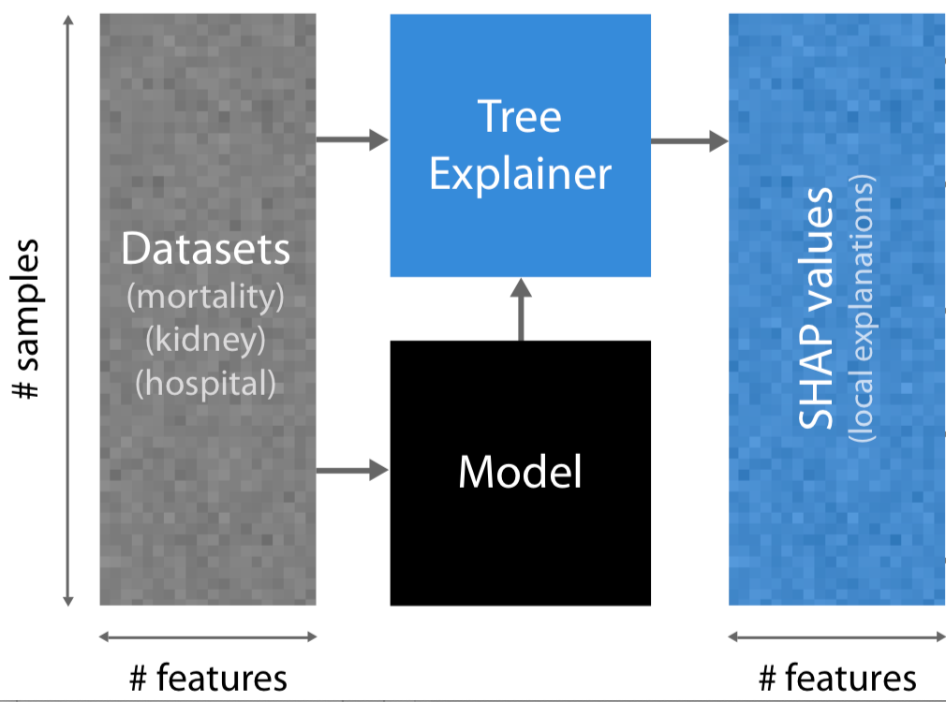
Representing global model structure with local feature importance values

Slide 37
Reveal rare high-magnitude mortality effects
Notes:
Make title shorter

Slide 38
Reveal rare high-magnitude mortality effects
Rare high magnitude effects
Notes:
Make title shorter

Slide 39
Reveal rare high-magnitude mortality effects
Not many ways to live longer…
Lots of ways to die young…
Notes:
Make title shorter

Slide 40
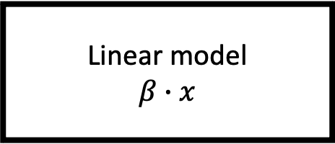
John
Customer data
Predicted risk
of default
$$x$$
DTI = 30
Delinquent = 10
Linear model
$$β∙x$$
$$\hat{y}$$
.
.
.
22%
Interpretable models:
Let the model be its own explanation.
Notes:
We'll start with a simple motivational example. This is John, a typical bank customer. Like many consumers today, when he applies for a loan, information about him is sent through a predictive model XX.
This model is designed to calculate the risk that John will have repayment problems, XX which, unfortunately for John, is 55%. And because his risk is high, the bank declines his loan application XX.
A natural first question John has XX is “Why?” The bank XX also want to know why, because these are key business decisions. But unfortunately for the data scientist that built this model XX, she used a complex model and so these questions are hard to answer XX …. XX

Slide 41
How-To: Interpretable models
Pick your model class
Pick your optimization method
Decide what explanation methods you will use
Linear model
Exact
Parameter reporting
Decision tree
Greedy
Partial dependence
GAM
Gradient boosting
Feature attribution
etc.
etc.
etc.
Notes:
We'll start with a simple motivational example. This is John, a typical bank customer. Like many consumers today, when he applies for a loan, information about him is sent through a predictive model XX.
This model is designed to calculate the risk that John will have repayment problems, XX which, unfortunately for John, is 55%. And because his risk is high, the bank declines his loan application XX.
A natural first question John has XX is “Why?” The bank XX also want to know why, because these are key business decisions. But unfortunately for the data scientist that built this model XX, she used a complex model and so these questions are hard to answer XX …. XX

Slide 42
What can go wrong: Interpretable models
Your model may have lower performance, and/or it may achieve its performance in unintuitive ways.
Your model may smuggle in hard to explain behavior.
Simple/High bias
Flexible/Low bias
Interpretable models still need explained, and the type of explanation you need may be different than the form of your model.
Models are often just a part of a larger system that needs explained.
Notes:
We'll start with a simple motivational example. This is John, a typical bank customer. Like many consumers today, when he applies for a loan, information about him is sent through a predictive model XX.
This model is designed to calculate the risk that John will have repayment problems, XX which, unfortunately for John, is 55%. And because his risk is high, the bank declines his loan application XX.
A natural first question John has XX is “Why?” The bank XX also want to know why, because these are key business decisions. But unfortunately for the data scientist that built this model XX, she used a complex model and so these questions are hard to answer XX …. XX

Slide 43
What can go wrong: Interpretable models
Your model may have lower performance, and/or it may achieve its performance in unintuitive ways.
Your model may have lower performance, and/or it may achieve its performance in unintuitive ways.
Your model may smuggle in hard to explain behavior.
Simple/High bias
Flexible/Low bias
Interpretable models still need explained, and the type of explanation you need may be different than the form of your model.
Models are often just a part of a larger system that needs explained.
Notes:
We'll start with a simple motivational example. This is John, a typical bank customer. Like many consumers today, when he applies for a loan, information about him is sent through a predictive model XX.
This model is designed to calculate the risk that John will have repayment problems, XX which, unfortunately for John, is 55%. And because his risk is high, the bank declines his loan application XX.
A natural first question John has XX is “Why?” The bank XX also want to know why, because these are key business decisions. But unfortunately for the data scientist that built this model XX, she used a complex model and so these questions are hard to answer XX …. XX

Slide 44
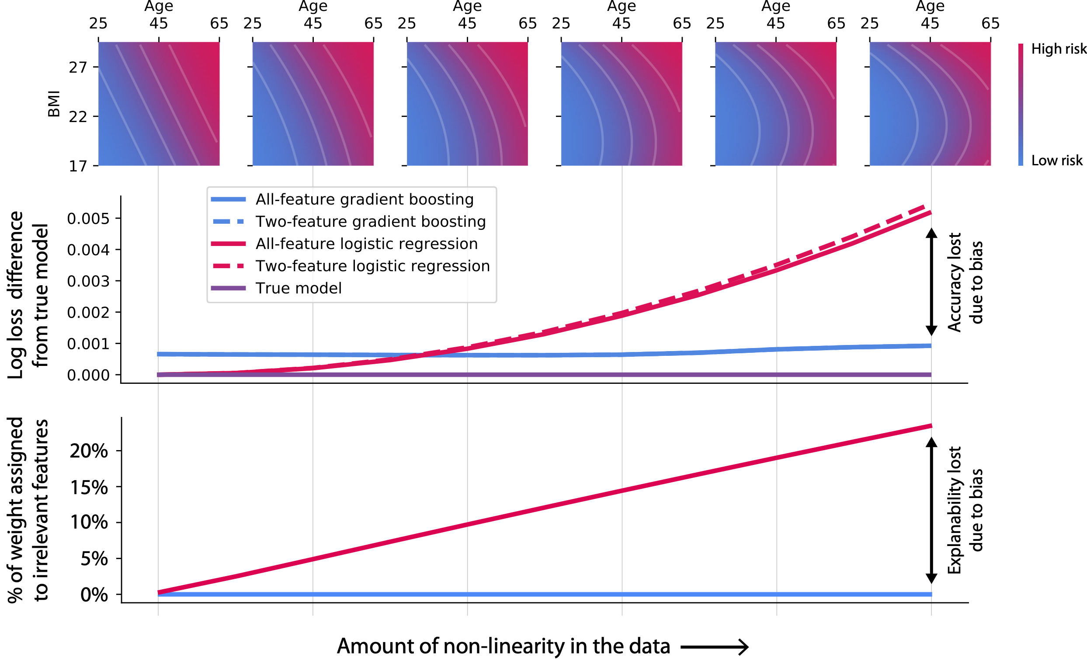

Slide 45
What can go wrong: Interpretable models
Your model may have lower performance, and/or it may achieve its performance in unintuitive ways.
Your model may smuggle in hard to explain behavior.
Simple/High bias
Flexible/Low bias
Interpretable models still need explained, and the type of explanation you need may be different than the form of your model.
Models are often just a part of a larger system that needs explained.
Models are often just a part of a larger system that needs explained.
Notes:
We'll start with a simple motivational example. This is John, a typical bank customer. Like many consumers today, when he applies for a loan, information about him is sent through a predictive model XX.
This model is designed to calculate the risk that John will have repayment problems, XX which, unfortunately for John, is 55%. And because his risk is high, the bank declines his loan application XX.
A natural first question John has XX is “Why?” The bank XX also want to know why, because these are key business decisions. But unfortunately for the data scientist that built this model XX, she used a complex model and so these questions are hard to answer XX …. XX

Slide 46

John
Customer data
Predicted risk
of default
$$x$$
DTI = 30
Delinquent = 10
model
$$\hat{y}$$
business rules
.
.
.
22%
No loan
System level explanation:
Account for the whole process of interest, not just a single ML component.
Notes:
We'll start with a simple motivational example. This is John, a typical bank customer. Like many consumers today, when he applies for a loan, information about him is sent through a predictive model XX.
This model is designed to calculate the risk that John will have repayment problems, XX which, unfortunately for John, is 55%. And because his risk is high, the bank declines his loan application XX.
A natural first question John has XX is “Why?” The bank XX also want to know why, because these are key business decisions. But unfortunately for the data scientist that built this model XX, she used a complex model and so these questions are hard to answer XX …. XX

Slide 47
John
Customer data
Predicted risk
of default
$$x$$
DTI = 30
Delinquent = 10
model
$$\hat{y}$$
business rules
.
.
.
bureau
score
22%
No loan
System level explanation:
Account for the whole process of interest, not just a single ML component.
Notes:
We'll start with a simple motivational example. This is John, a typical bank customer. Like many consumers today, when he applies for a loan, information about him is sent through a predictive model XX.
This model is designed to calculate the risk that John will have repayment problems, XX which, unfortunately for John, is 55%. And because his risk is high, the bank declines his loan application XX.
A natural first question John has XX is “Why?” The bank XX also want to know why, because these are key business decisions. But unfortunately for the data scientist that built this model XX, she used a complex model and so these questions are hard to answer XX …. XX

Slide 48
What can go wrong: Counterfactual examples
You are missing important model behavior because you don’t have examples that illustrate it.
You are missing important model behavior because you don’t have examples that illustrate it.
You can’t discern meaningful patterns because there are too many examples to understand.
Few examples
Many examples
Notes:
We'll start with a simple motivational example. This is John, a typical bank customer. Like many consumers today, when he applies for a loan, information about him is sent through a predictive model XX.
This model is designed to calculate the risk that John will have repayment problems, XX which, unfortunately for John, is 55%. And because his risk is high, the bank declines his loan application XX.
A natural first question John has XX is “Why?” The bank XX also want to know why, because these are key business decisions. But unfortunately for the data scientist that built this model XX, she used a complex model and so these questions are hard to answer XX …. XX

Slide 49
Dependence plots reveal the increased danger of early onset high blood pressure
Vertical dispersion is
driven by interaction effects
Notes:
Animate at the least

Slide 50
Uncovering subtle interaction effects
Notes:
Make title shorter

Slide 51
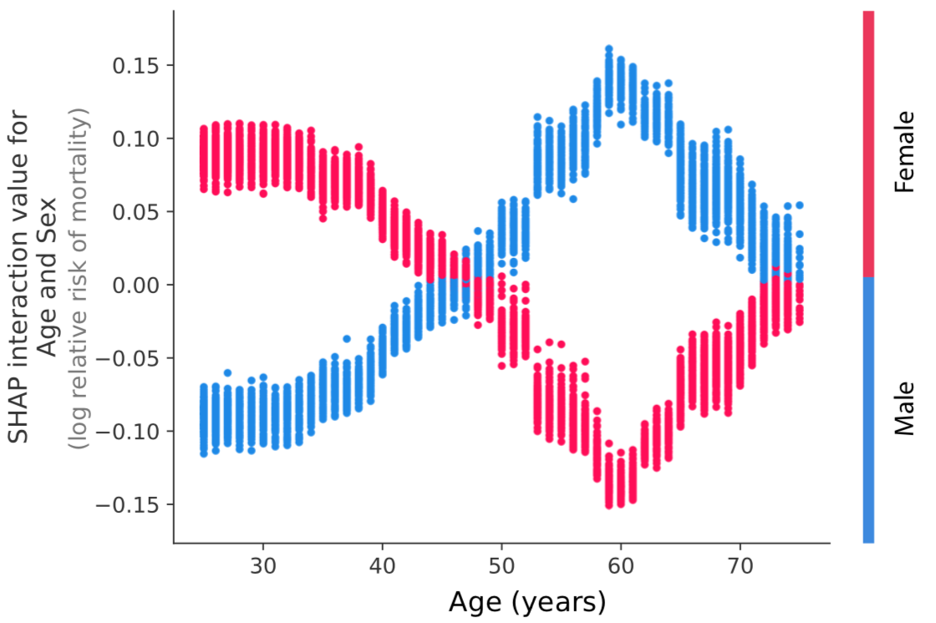
The varying risk of sex over a lifetime
Notes:
Make title shorter

Slide 52
Thanks!
Notes:
We'll start with a simple motivational example. This is John, a typical bank customer. Like many consumers today, when he applies for a loan, information about him is sent through a predictive model XX.
This model is designed to calculate the risk that John will have repayment problems, XX which, unfortunately for John, is 55%. And because his risk is high, the bank declines his loan application XX.
A natural first question John has XX is “Why?” The bank XX also want to know why, because these are key business decisions. But unfortunately for the data scientist that built this model XX, she used a complex model and so these questions are hard to answer XX …. XX

